Slide 1
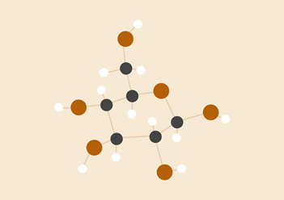
CS 6843
Spring 2016
Final Exam Project
Warlon Zeng
Alan Ni
Chukwuyuem J. Onvibe
Matthew Chan
Tsung-Cheng Tsai
Kai Chen Hsieh

Slide 2
Overview
What’s the Problem?
What’s Going On?
Path to Solution
IP Addressing Schema
Network Architecture Design
Relevant Protocols
Access Technologies
ISPs Application Profiles

Slide 3
What’s the Problem?
People complaining about the slow-access on files, email and VoIP when there are excess amount users trying to access the same resource or server.
This condition is called performance degrade.

Slide 4
What’s Going On?
The company is planning significant expansion into the new markets by decreasing time-to-market for their core set of products and increasing the global workforce hiring, making networks more congested.
The bottleneck may contain different reasons including location, bandwidth, and interface limits.

Slide 5
Path to Solution
IP Addressing Schema
Network Architecture Design
Relevant Protocols
Access Technologies
ISPs Application Profiles

Slide 6
Main Office & Regional Headquarters
Main Office
Boston, MA, 210
Regional headquarters
Paris, France, 130
Buenos Aires, Argentina, 130
Sydney, Australia, 130
In accounting/finance, human resources, legal, corporate IT, facilities management, executive management and strategy groups. Total number of employees across all HQ offices is about 600.

Slide 7
Global Client Centers
Berlin, 200
Atlanta, 150
Tokyo, 150
Employing approximately 500 high quality designers, engineers and architects.

Slide 8
Lower-level Support Staff Departments
China, 750
Canada, 750
United Arab Emirates, 750
Malaysia, 750
Employing 3000 people.

Slide 9
Software Development Centers
Israel, 70
India, 140
Ukraine, 90
A total of 300 employees working on multiple client-server and web-based software projects to support global operations, AutoCAD, and other drawing packages and document management systems and many others.

Slide 10
Call Center
Puerto Rico, 100
Supports customer inquiries and complaints.

Slide 11
Sales organization
There are approximately 30 small and medium size offices major geographical areas (Americas, Europe/Middle East, Asia Pacific) to a total of 1000 employees.
Most of the sales employees are mobile.

Slide 12
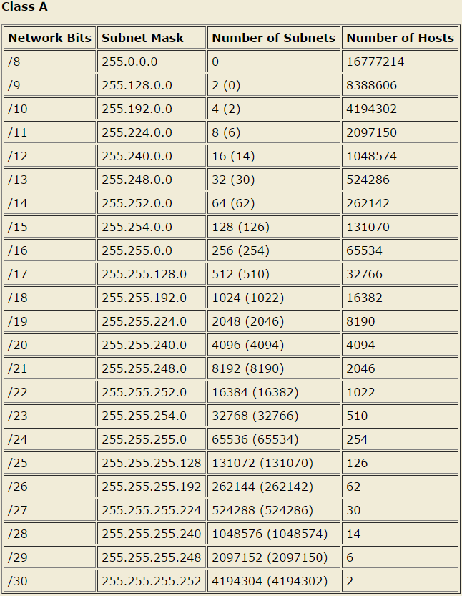

IP Addressing Schema
Use Class A addressing range
10.10.0.0~10.255.255.255
Private IPv4 Addresses
Use Class C subnet masks:
255.255.255
255.255.254
VLAN IP corresponds to IP Addresses
VLAN # are set default

Slide 13
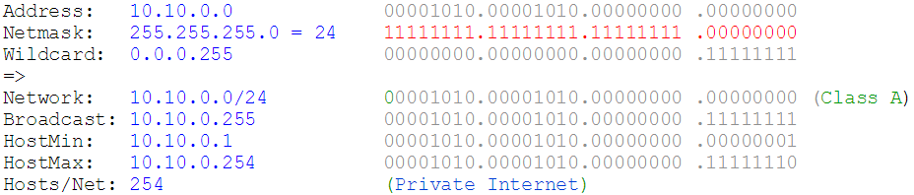
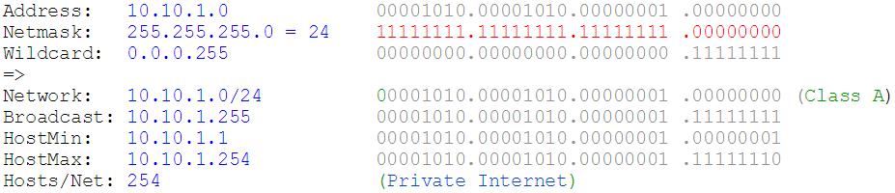
Sample Calculation for 255.255.255
VLAN Address: 10.10.0.0; Netmask bits: 24; Subnet Mask: 255.255.255.0
10.10.0.0
10.10.1.0

Slide 14
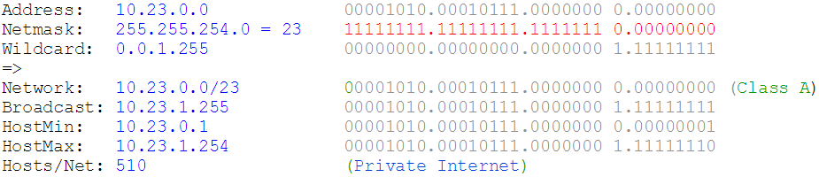
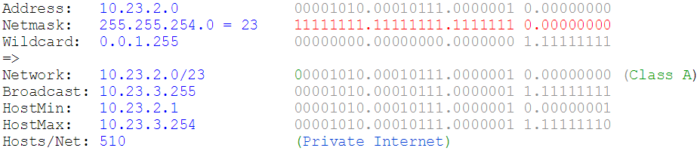
Sample Calculation for 255.255.254
VLAN Address: 10.23.0.0; Netmask bits: 23; Subnet Mask: 255.255.254.0
10.23.0.0
10.23.2.0

Slide 15
Main Office IP Addressing Schema
Main Office – Boston, MA
Vlan # | Vlan IP | Subnet mask | IP | People | Devices | Department/Function
0 | 10.10.0.0 | 255.255.255.0 | 10.10.0.1～ 10.10.0.50 |  | 50 | VOIP
1 | 10.10.1.0 | 255.255.255.0 | 10.10.1.1～ 10.10.1.90 | 30 | 90 | Accounting/ Finance
2 | 10.10.2.0 | 255.255.255.0 | 10.10.2.1～ 10.10.2.90 | 10 | 30 | HR
3 | 10.10.3.0 | 255.255.255.0 | 10.10.3.1～ 10.10.3.90 | 30 | 90 | Legal
4 | 10.10.4.0 | 255.255.255.0 | 10.10.4.1～ 10.10.4.90 | 30 | 90 | Corporate IT
5 | 10.10.5.0 | 255.255.255.0 | 10.10.5.1～ 10.10.5.60 | 20 | 60 | Facilities management
6 | 10.10.6.0 | 255.255.255.0 | 10.10.6.1～ 10.10.6.60 | 20 | 60 | Executive management
7 | 10.10.7.0 | 255.255.255.0 | 10.10.7.1～ 10.10.7.120 | 40 | 120 | Strategy groups
8 | 10.10.8.0 | 255.255.255.0 | 10.10.8.1～ 10.10.8.90 | 30 | 90 | Treasury
9 | 10.10.9.0 | 255.255.255.0 | 10.10.9.1～ 10.10.9.50 |  | 10 | Server
10 | 10.10.10.0 | 255.255.255.0 | 10.10.10.1～ 10.10.10.10 |  | 10 | Printer
Total |  |  |  | 210 | 700

Slide 16
Regional Headquarters - Paris, France
Regional HQ – Paris, France
Vlan # | Vlan IP | Subnet Mask | IP | People | Devices | Department/Function
0 | 10.26.0.0 | 255.255.255.0 | 10.26.0.1～ 10.26.0.40 |  | 40 | VOIP
1 | 10.26.1.0 | 255.255.255.0 | 10.26.1.1～ 10.26.1.60 | 20 | 60 | Accounting/ Finance
2 | 10.26.2.0 | 255.255.255.0 | 10.26.2.1～ 10.26.2.15 | 5 | 15 | HR
3 | 10.26.3.0 | 255.255.255.0 | 10.26.3.1～ 10.26.3.45 | 15 | 45 | Legal
4 | 10.26.4.0 | 255.255.255.0 | 10.26.4.1～ 10.26.4.60 | 20 | 60 | Corporate IT
5 | 10.26.5.0 | 255.255.255.0 | 10.26.5.1～ 10.26.5.30 | 10 | 30 | Facilities management
6 | 10.26.6.0 | 255.255.255.0 | 10.26.6.1～ 10.26.6.30 | 10 | 30 | Executive management
7 | 10.26.7.0 | 255.255.255.0 | 10.26.7.1～ 10.26.7.90 | 30 | 90 | Strategy groups
8 | 10.26.8.0 | 255.255.255.0 | 10.26.8.1～ 10.26.8.60 | 20 | 60 | Treasury
9 | 10.26.9.0 | 255.255.255.0 | 10.26.9.1～ 10.26.9.40 |  | 8 | Server
10 | 10.26.10.0 | 255.255.255.0 | 10.26.10.1～ 10.26.10.8 |  | 8 | Printer
Total |  |  |  | 130 | 446

Slide 17
Regional Headquarters - Buenos Aires, Argentina
Regional HQ –Buenos Aires, Argentina
Vlan # | Vlan IP | Subnet Mask | IP | People | Devices | Department/Function
0 | 10.27.0.0 | 255.255.255.0 | 10.27.0.1～ 10.27.0.40 |  | 40 | VOIP
1 | 10.27.1.0 | 255.255.255.0 | 10.27.1.1～ 10.27.1.60 | 20 | 60 | Accounting/ Finance
2 | 10.27.2.0 | 255.255.255.0 | 10.27.2.1～ 10.27.2.15 | 5 | 15 | HR
3 | 10.27.3.0 | 255.255.255.0 | 10.27.3.1～ 10.27.3.45 | 15 | 45 | Legal
4 | 10.27.4.0 | 255.255.255.0 | 10.27.4.1～ 10.27.4.60 | 20 | 60 | Corporate IT
5 | 10.27.5.0 | 255.255.255.0 | 10.27.5.1～ 10.27.5.30 | 10 | 30 | Facilities management
6 | 10.27.6.0 | 255.255.255.0 | 10.27.6.1～ 10.27.6.30 | 10 | 30 | Executive management
7 | 10.27.7.0 | 255.255.255.0 | 10.27.7.1～ 10.27.7.90 | 30 | 90 | Strategy groups
8 | 10.27.8.0 | 255.255.255.0 | 10.27.8.1～ 10.27.8.60 | 20 | 60 | Treasury
9 | 10.27.9.0 | 255.255.255.0 | 10.27.9.1～ 10.27.9.50 |  | 10 | Server
10 | 10.27.10.0 | 255.255.255.0 | 10.27.10.1～ 10.27.10.10 |  | 10 | Printer
Total |  |  |  | 130 | 450

Slide 18
Regional Headquarters - Sydney, Australia
Regional HQ –Sydney, Australia
Vlan # | Vlan IP | Subnet Mask | IP | People | Devices | Department/Function
0 | 10.28.0.0 | 255.255.255.0 | 10.28.0.1～ 10.28.0.40 |  | 40 | VOIP
1 | 10.28.1.0 | 255.255.255.0 | 10.28.1.1～ 10.28.1.60 | 20 | 60 | Accounting/ Finance
2 | 10.28.2.0 | 255.255.255.0 | 10.28.2.1～ 10.28.2.15 | 5 | 15 | HR
3 | 10.28.3.0 | 255.255.255.0 | 10.28.3.1～ 10.28.3.45 | 15 | 45 | Legal
4 | 10.28.4.0 | 255.255.255.0 | 10.28.4.1～ 10.28.4.60 | 20 | 60 | Corporate IT
5 | 10.28.5.0 | 255.255.255.0 | 10.28.5.1～ 10.28.5.30 | 10 | 30 | Facilities management
6 | 10.28.6.0 | 255.255.255.0 | 10.28.6.1～ 10.28.6.30 | 10 | 30 | Executive management
7 | 10.28.7.0 | 255.255.255.0 | 10.28.7.1～ 10.28.7.90 | 30 | 90 | Strategy groups
8 | 10.28.8.0 | 255.255.255.0 | 10.28.8.1～ 10.28.8.60 | 20 | 60 | Treasury
9 | 10.28.9.0 | 255.255.255.0 | 10.28.9.1～ 10.28.9.50 |  | 10 | Server
10 | 10.28.10.0 | 255.255.255.0 | 10.28.10.1～ 10.28.10.10 |  | 10 | Printer
Total |  |  |  | 130 | 450

Slide 19
Global Client Center - Berlin
Global Client Center - Berlin
Vlan # | Vlan IP | Subnet Mask | IP | People | Devices | Department/Function
0 | 10.11.0.0 | 255.255.255.0 | 10.11.0.1～10.11.0.40 |  | 40 | VOIP
1 | 10.11.1.0 | 255.255.255.0 | 10.11.1.1～10.11.1.240 | 80 | 240 | Designer
2 | 10.11.2.0 | 255.255.255.0 | 10.11.2.1～10.11.2.180 | 60 | 180 | Engineer
3 | 10.11.3.0 | 255.255.255.0 | 10.11.3.1～10.11.3.180 | 60 | 180 | Architect
4 | 10.11.4.0 | 255.255.255.0 | 10.11.4.1～10.11.4.50 |  | 10 | Server
5 | 10.11.5.0 | 255.255.255.0 | 10.11.5.1～10.11.5.10 |  | 10 | Printer
Total |  |  |  | 200 | 660

Slide 20
Global Client Center - Atlanta
Global Client Center - Atlanta
Vlan # | Vlan IP | Subnet Mask | IP | People | Devices | Department/Function
0 | 10.12.0.0 | 255.255.255.0 | 10.12.0.1～10.12.0.30 |  | 30 | VOIP
1 | 10.12.1.0 | 255.255.255.0 | 10.12.1.1～10.12.1.150 | 50 | 150 | Designer
2 | 10.12.2.0 | 255.255.255.0 | 10.12.2.1～10.12.2.150 | 50 | 150 | Engineer
3 | 10.12.3.0 | 255.255.255.0 | 10.12.3.1～10.12.3.150 | 50 | 150 | Architect
4 | 10.12.4.0 | 255.255.255.0 | 10.12.4.1～10.12.4.40 |  | 8 | Server
5 | 10.12.5.0 | 255.255.255.0 | 10.12.5.1～10.12.5.7 |  | 7 | Printer
Total |  |  |  | 150 | 495

Slide 21
Global Client Center - Tokyo
Global Client Center - Tokyo
Vlan # | Vlan IP | Subnet Mask | IP | People | Devices | Department/Function
0 | 10.13.0.0 | 255.255.255.0 | 10.13.0.1～10.13.0.30 |  | 30 | VOIP
1 | 10.13.1.0 | 255.255.255.0 | 10.13.1.1～10.13.1.150 | 50 | 150 | Designer
2 | 10.13.2.0 | 255.255.255.0 | 10.13.2.1～10.13.2.150 | 50 | 150 | Engineer
3 | 10.13.3.0 | 255.255.255.0 | 10.13.3.1～10.13.3.150 | 50 | 150 | Architect
4 | 10.13.4.0 | 255.255.255.0 | 10.13.4.1～10.13.4.50 |  | 8 | Server
5 | 10.13.5.0 | 255.255.255.0 | 10.13.5.1～10.13.5.7 |  | 7 | Printer
Total |  |  |  | 150 | 495

Slide 22
Lower-level support staff department - China
Lower-­level support staff department - China
Vlan # | Vlan IP | Subnet Mask | IP | People | Devices | Department/Function
0 | 10.14.0.0 | 255.255.255.0 | 10.14.0.1～10.14.0.200 |  | 200 | VOIP
1 | 10.14.1.0 | 255.255.255.0 | 10.14.1.1～10.14.1.250 | 250 | 250 | Department1
2 | 10.14.2.0 | 255.255.255.0 | 10.14.2.1～10.14.2.250 | 250 | 250 | Department2
3 | 10.14.3.0 | 255.255.255.0 | 10.14.3.1～10.14.3.250 | 250 | 250 | Department3
4 | 10.14.4.0 | 255.255.255.0 | 10.14.4.1～10.14.4.100 |  | 20 | Server
5 | 10.14.5.0 | 255.255.255.0 | 10.14.5.1～10.14.5.20 |  | 20 | Printer
Total |  |  |  | 750 | 990

Slide 23
Lower-level support staff department - Canada
Lower-­level support staff department - Canada
Vlan # | Vlan IP | Subnet Mask | IP | People | Devices | Department/Function
0 | 10.15.0.0 | 255.255.255.0 | 10.15.0.1～10.15.0.200 |  | 200 | VOIP
1 | 10.15.1.0 | 255.255.255.0 | 10.15.1.1～10.15.1.250 | 250 | 250 | Department1
2 | 10.15.2.0 | 255.255.255.0 | 10.15.2.1～10.15.2.250 | 250 | 250 | Department2
3 | 10.15.3.0 | 255.255.255.0 | 10.15.3.1～10.15.3.250 | 250 | 250 | Department3
4 | 10.15.4.0 | 255.255.255.0 | 10.15.4.1～10.15.4.100 |  | 20 | Server
5 | 10.15.5.0 | 255.255.255.0 | 10.15.5.1～10.15.5.20 |  | 20 | Printer
Total |  |  |  | 750 | 990

Slide 24
Lower-level support staff department - United Arab Emirates
Lower-­level support staff department - United Arab Emirates
Vlan # | Vlan IP | Subnet Mask | IP | People | Devices | Department/Function
0 | 10.16.0.0 | 255.255.255.0 | 10.16.0.1～10.16.0.200 |  | 200 | VOIP
1 | 10.16.1.0 | 255.255.255.0 | 10.16.1.1～10.16.1.250 | 250 | 250 | Department1
2 | 10.16.2.0 | 255.255.255.0 | 10.16.2.1～10.16.2.250 | 250 | 250 | Department2
3 | 10.16.3.0 | 255.255.255.0 | 10.16.3.1～10.16.3.250 | 250 | 250 | Department3
4 | 10.16.4.0 | 255.255.255.0 | 10.16.4.1～10.16.4.100 |  | 20 | Server
5 | 10.16.5.0 | 255.255.255.0 | 10.16.5.1～10.16.5.20 |  | 20 | Printer
Total |  |  |  | 750 | 990

Slide 25
Lower-level support staff department - Malaysia
Lower-­level support staff department - Malaysia
Vlan # | Vlan IP | Subnet Mask | IP | People | Devices | Department/Function
0 | 10.17.0.0 | 255.255.255.0 | 10.17.0.1～10.17.0.200 |  | 200 | VOIP
1 | 10.17.1.0 | 255.255.255.0 | 10.17.1.1～10.17.1.250 | 250 | 250 | Department1
2 | 10.17.2.0 | 255.255.255.0 | 10.17.2.1～10.17.2.250 | 250 | 250 | Department2
3 | 10.17.3.0 | 255.255.255.0 | 10.17.3.1～10.17.3.250 | 250 | 250 | Department3
4 | 10.17.4.0 | 255.255.255.0 | 10.17.4.1～10.17.4.100 |  | 20 | Server
5 | 10.17.5.0 | 255.255.255.0 | 10.17.5.1～10.17.5.20 |  | 20 | Printer
Total |  |  |  | 750 | 990

Slide 26
Software Development Center - Israel
Software Development Center - Israel
Vlan # | Vlan IP | Subnet Mask | IP | People | Devices | Department/Function
0 | 10.18.0.0 | 255.255.255.0 | 10.18.0.1～10.18.0.30 |  | 30 | VOIP
1 | 10.18.1.0 | 255.255.255.0 | 10.18.1.1～10.18.1.120 | 30 | 120 | Global operations support
2 | 10.18.2.0 | 255.255.255.0 | 10.18.2.1～10.18.2.80 | 20 | 80 | AutoCAD support
3 | 10.18.3.0 | 255.255.255.0 | 10.18.3.1～10.18.3.40 | 10 | 40 | Drawing packages support
4 | 10.18.4.0 | 255.255.255.0 | 10.18.4.1～10.18.4.40 | 10 | 40 | Document Management systems support
5 | 10.18.5.0 | 255.255.255.0 | 10.18.5.1～10.18.5.40 |  | 8 | Server
6 | 10.18.6.0 | 255.255.255.0 | 10.18.6.1～10.18.6.8 |  | 8 | Printer
Total |  |  |  | 70 | 326

Slide 27
Software Development Center - India
Software Development Center - India
Vlan # | Vlan IP | Subnet Mask | IP | People | Devices | Department/Function
0 | 10.19.0.0 | 255.255.255.0 | 10.19.0.1～10.19.0.40 |  | 40 | VOIP
1 | 10.19.1.0 | 255.255.255.0 | 10.19.1.1～10.19.1.200 | 50 | 200 | Global operations support
2 | 10.19.2.0 | 255.255.255.0 | 10.19.2.1～10.19.2.200 | 50 | 200 | AutoCAD support
3 | 10.19.3.0 | 255.255.255.0 | 10.19.3.1～10.19.3.80 | 20 | 80 | Drawing packages support
4 | 10.19.4.0 | 255.255.255.0 | 10.19.4.1～10.19.4.80 | 20 | 80 | Document Management systems support
5 | 10.19.5.0 | 255.255.255.0 | 10.19.5.1～10.19.5.50 |  | 10 | Server
6 | 10.19.6.0 | 255.255.255.0 | 10.19.6.1～10.19.6.8 |  | 8 | Printer
Total |  |  |  | 140 | 638

Slide 28
Software Development Center - Ukraine
Software Development Center - Ukraine
Vlan # | Vlan IP | Subnet Mask | IP | People | Devices | Department/Function
0 | 10.20.0.0 | 255.255.255.0 | 10.20.0.1～10.20.0.40 |  | 40 | VOIP
1 | 10.20.1.0 | 255.255.255.0 | 10.20.1.1～10.20.1.140 | 35 | 140 | Global operations support
2 | 10.20.2.0 | 255.255.255.0 | 10.20.2.1～10.20.2.140 | 35 | 140 | AutoCAD support
3 | 10.20.3.0 | 255.255.255.0 | 10.20.3.1～10.20.3.40 | 10 | 40 | Drawing packages support
4 | 10.20.4.0 | 255.255.255.0 | 10.20.4.1～10.20.4.40 | 10 | 40 | Document Management systems support
5 | 10.20.5.0 | 255.255.255.0 | 10.20.5.1～10.20.5.50 |  | 10 | Server
6 | 10.20.6.0 | 255.255.255.0 | 10.20.6.1～10.20.6.8 |  | 8 | Printer
Total |  |  |  | 90 | 418

Slide 29
Sales Organization - Medium Office
Sales Organization - Medium Office (80 people)
Vlan # | Vlan IP | Subnet Mask | IP | People | Devices | Department/Function
0 | 10.21.0.0 | 255.255.255.0 | 10.21.0.1～10.21.0.10 |  | 10 | VOIP
1 | 10.21.1.0 | 255.255.255.0 | 10.21.1.1～10.21.1.30 | 10 | 30 | Department1
2 | 10.21.2.0 | 255.255.255.0 | 10.21.2.1～10.21.2.30 | 10 | 30 | Department2
3 | 10.21.3.0 | 255.255.255.0 | 10.21.3.1～10.21.3.250 | 60 | 250 | Mobile Users
4 | 10.21.4.0 | 255.255.255.0 | 10.21.4.1～10.21.4.20 |  | 4 | Server
5 | 10.21.5.0 | 255.255.255.0 | 10.21.5.1～10.21.5.10 |  | 10 | Printer
Total |  |  |  | 80 | 334

Slide 30
Sales Organization - Small Office
Sales Organization - Small Office (40 people)
Vlan # | Vlan IP | Subnet Mask | IP | People | Devices | Department/Function
0 | 10.22.0.0 | 255.255.255.0 | 10.22.0.1～10.22.0.5 |  | 5 | VOIP
1 | 10.22.1.0 | 255.255.255.0 | 10.22.1.1～10.22.1.15 | 5 | 15 | Department1
2 | 10.22.2.0 | 255.255.255.0 | 10.22.2.1～10.22.2.15 | 5 | 15 | Department2
3 | 10.22.3.0 | 255.255.255.0 | 10.22.3.1～10.22.3.250 | 30 | 250 | Mobile Users
4 | 10.22.4.0 | 255.255.255.0 | 10.22.4.1～10.22.4.20 |  | 4 | Server
5 | 10.22.5.0 | 255.255.255.0 | 10.22.5.1～10.22.5.5 |  | 5 | Printer
Total |  |  |  | 40 | 294

Slide 31
Sales Organization - America
Sales Organization - America
Vlan # | Vlan IP | Subnet Mask | IP | People | Devices | Department/Function
0 | 10.23.0.0 | 255.255.254.0 | 10.23.0.1~10.23.1.100 | 80 | 355 | Medium office1
2 | 10.23.2.0 | 255.255.254.0 | 10.23.2.1~10.23.3.100 | 80 | 355 | Medium office2
4 | 10.23.4.0 | 255.255.254.0 | 10.23.4.1 ~ 10.23.5.100 | 80 | 355 | Medium office3
6 | 10.23.6.0 | 255.255.254.0 | 10.23.6.1 ~ 10.23.7.60 | 40 | 315 | Small office1
8 | 10.23.8.0 | 255.255.254.0 | 10.23.8.1 ~ 10.23.9.60 | 40 | 315 | Small office2
Total |  |  |  | 320 | 1695

Slide 32
Sales Organization - Europe/Middle East
Sales Organization - Europe/Middle East
Vlan # | Vlan IP | Subnet Mask | IP | People | Devices | Department/Function
0 | 10.24.0.0 | 255.255.254.0 | 10.24.0.1~10.24.1.100 | 80 | 355 | Medium office1
2 | 10.24.2.0 | 255.255.254.0 | 10.24.2.1~10.24.3.100 | 80 | 355 | Medium office2
4 | 10.24.4.0 | 255.255.254.0 | 10.24.4.1 ~ 10.24.5.100 | 80 | 355 | Medium office3
6 | 10.24.6.0 | 255.255.254.0 | 10.24.6.1 ~ 10.24.7.60 | 40 | 315 | Small office1
8 | 10.24.8.0 | 255.255.254.0 | 10.24.8.1 ~ 10.24.9.60 | 40 | 315 | Small office2
Total |  |  |  | 320 | 1695

Slide 33
Sales Organization - Asia Pacific
Sales Organization – Asia Pacific
Vlan # | Vlan IP | Subnet Mask | IP | People | Devices | Department/Function
0 | 10.25.0.0 | 255.255.254.0 | 10.25.0.1~10.25.1.100 | 80 | 355 | Medium office1
2 | 10.25.2.0 | 255.255.254.0 | 10.25.2.1~10.25.3.100 | 80 | 355 | Medium office2
4 | 10.25.4.0 | 255.255.254.0 | 10.25.4.1 ~ 10.25.5.100 | 80 | 355 | Medium office3
6 | 10.25.6.0 | 255.255.254.0 | 10.25.6.1 ~ 10.25.7.60 | 40 | 315 | Small office1
8 | 10.25.8.0 | 255.255.254.0 | 10.25.8.1 ~ 10.25.9.60 | 40 | 315 | Small office2
10 | 10.25.10.0 | 255.255.254.0 | 10.25.10.1 ~ 10.25.11.60 | 40 | 315 | Small office3
Total |  |  |  | 360 | 2010

Slide 34
Call Center - Puerto Rico
Call-center – Puerto Rico
Vlan # | Vlan IP | Subnet Mask | IP | People | Devices | Department/Function
0 | 10.29.0.0 | 255.255.255.0 | 10.29.0.1~10.29.0.20 |  | 20 | VOIP
1 | 10.29.1.0 | 255.255.255.0 | 10.29.1.1~10.29.1.100 | 100 | 100 | Call center
2 | 10.29.2.0 | 255.255.255.0 | 10.29.2.1~10.29.2.100 |  | 20 | Server
3 | 10.29.3.0 | 255.255.255.0 | 10.29.3.1~10.29.3.20 |  | 20 | Printer
Total |  |  |  | 100 | 160

Slide 35
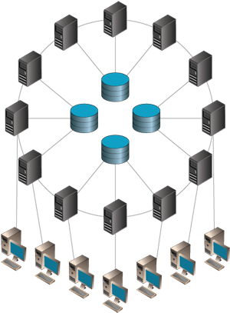
Network Architecture Design
Multiple client-servers emphasize a distributed system to uphold transparency, openness, concurrency, security, resilience to failure, and scalability
Network architecture will be re-architectured to resolve these problems:
Server location
VLAN - Link aggregation
Backup and mirror Server
Heartbeat channels for detecting server down
Clean network environment

Slide 36

Server Location
Physical distance of servers reflect in the delay time of access directly
Building the servers at proper locations minimizes delay.
1 mirror e-mail server for each main continent (North America, Europe, Asia, etc).
These e-mail servers have different web portals but with same domain name as e-mail address.
There will be individual servers for other general purpose servers (file server, VOIP) in every branch division unit of the company.
These servers require more bandwidth and lower delay.

Slide 37
VLAN - Link Aggregation
Link aggregation is a special case of VLAN
Requires software/hardware supporting on both switches and devices.
Allows combining multiple different ethernet interfaces as one virtual interface.
Traffic going through the IP on this virtual interface will be distributed among multiple physical interfaces, which increases much loading capacity.
Virtual IP
IP 1
IP 2
Server

Slide 38
Backup and Mirror Server
Backup servers and mirror servers will be added into cluster sets (high availability).
When the active server is providing the service, the backup (passive) server will be in standby mode and mirroring the data from active server.
Passive server will become active when the original active server goes down.

Slide 39
Heartbeat Channels Used for Detecting Server Down
Extra IP and ethernet interfaces will be assigned for both active and passive servers as heartbeat channels.
These channels allow active and passive servers to monitor the status of each other.
When the active server goes down, the passive server becomes the new active server and start taking over the VLAN virtual IP on link aggregation interfaces.
The users will not notice the IP changes after servers switched over.
Heartbeat channel
Active server
Become new active and take over the virtual IP
Server down
Passive server
Active server

Slide 40
Clean network environment
Using another type of port-based VLAN to isolate the local network traffic of different offices
Give us a cleaner environment in local network
The subnet mask will be set properly on each device to make sure they belong to the right subnet.
These devices from different subnets can still access each other through routing protocol.

Slide 41
Relevant Protocols
TCP - Emails, File Transfers
UDP - Streaming, VoIP
DHCP - Mobile connection
HTTP - Hypertext Transfer Protocol
FTP - File Transfer Protocol
SMTP - Simple Mail Transfer Protocol

Slide 42
Transmission Control Protocol
Connection-oriented reliable transport
Reliable, in-order delivery
Flow control
Timeout events (Timer)
Sequence numbers, pipelined segments and Acknowledgements (ACK)
Connection setup
3-way Handshake
For regular applications on the internet that rely on transmission such as Email and File Transfer.

Slide 43
User Datagram Protocol
Connectionless transport
Unreliable, unordered delivery
Focused in delivering on low latency
Cut and dry - no handshaking
For streaming applications on the internet that rely on minimal latency such as VoIP.

Slide 44
Dynamically Host Control Protocol
Dynamically obtain IP Addresses from the network server
Renew lease
Holds addresses on connection
Dynamically obtain IP Addresses from the network server. For workstations, laptops, and mobile devices that comes and goes.

Slide 45
Access Technologies
Ethernet
Cable broadband
Coaxial copper
Wi-fi
IEEE 802.11 standards
For performance: 802.11/n/ac

Slide 46
ISPs Application Profiles
ISPs Application Profiles
Location (users) | Telecom | Protocol | Acceptable Delay | Recommended bandwidth
Boston, MA (210) | Verizon | TCP, UDP, DHCP | 10 ms | 2 x 1Gb / s
Paris, France (130) | Orange S.A. | TCP, UDP, DHCP | 200 ms | 250Mb / s
Buenos Aires, Argentina (130) | Telecom Argentina | TCP, UDP, DHCP | 150 ms | 250Mb / s
Sydney, Australia (130) | Telstra | TCP, UDP, DHCP | 250 ms | 250Mb / s
Berlin (200) | Deutsche Telekom AG | TCP, UDP, DHCP | 200 ms | 1 Gb / s
Atlanta (150) | AT&T Uverse | TCP, UDP, DHCP | 75 ms | 500MB / s
Tokyo (150) | Nippon Telegraph & Tel | TCP, UDP, DHCP | 250 ms | 1 Gb / s
China (750) | China Telecom | TCP, UDP, DHCP | 300 ms | 2 x 1Gb / s
Canada (750) | Rogers | TCP, UDP, DHCP | 50 ms | 2 x 1Gb / s
UAE (750) | Etisalat | TCP, UDP, DHCP | 200 ms | 2 x 1Gb / s
Malaysia (750) | Time | TCP, UDP, DHCP | 250 ms | 2 x 1Gb / s
Israel (70) | Bezeq | TCP, UDP, DHCP | 200 ms | 250Mb / s
India (140) | BEAM Telecom | TCP, UDP, DHCP | 300 ms | 250Mb / s
Ukraine (90) | Ukrtelecom | TCP, UDP, DHCP | 250 ms | 250Mb / s
Puerto Rico (100) | Claro Puerto Rico | TCP, UDP, DHCP | 150 ms | 250Mb / s

